Slide 1
Neutron Interactions
Tom Bryant and Josh Wainwright

Slide 2
Objectives
Study behaviour of the NaI(Tl) detector and the BF₃ proportional counter.
Measure the deuteron binding energy
Measure the flux of neutrons as a function of distance from an Am-Be source in a water bath. Use the results to derive a measure of how neutrons are moderated in water.

Slide 3
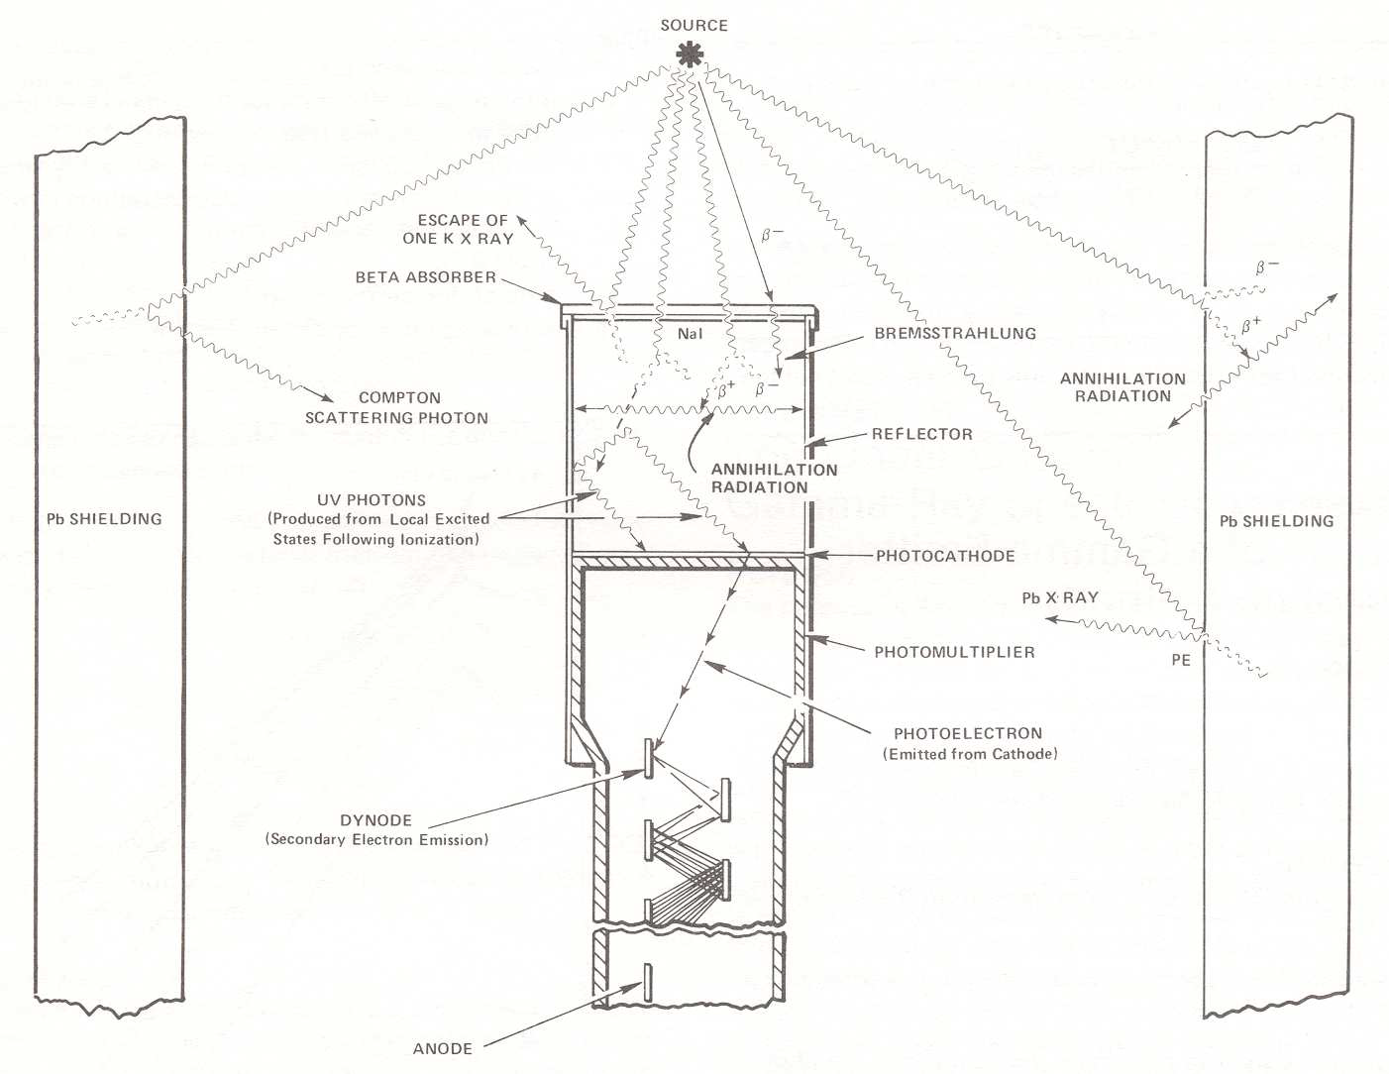
NaI(Tl) Detector

Slide 4
BF₃ Detector
Cathode
(1.9 kV)
Anode
(0 Volts)
Ion
Na
Ion
α
Ion

Slide 5
Resolution and Efficiency NaI(Tl)

Slide 6
Resolution and Efficiency BF₃

Slide 7
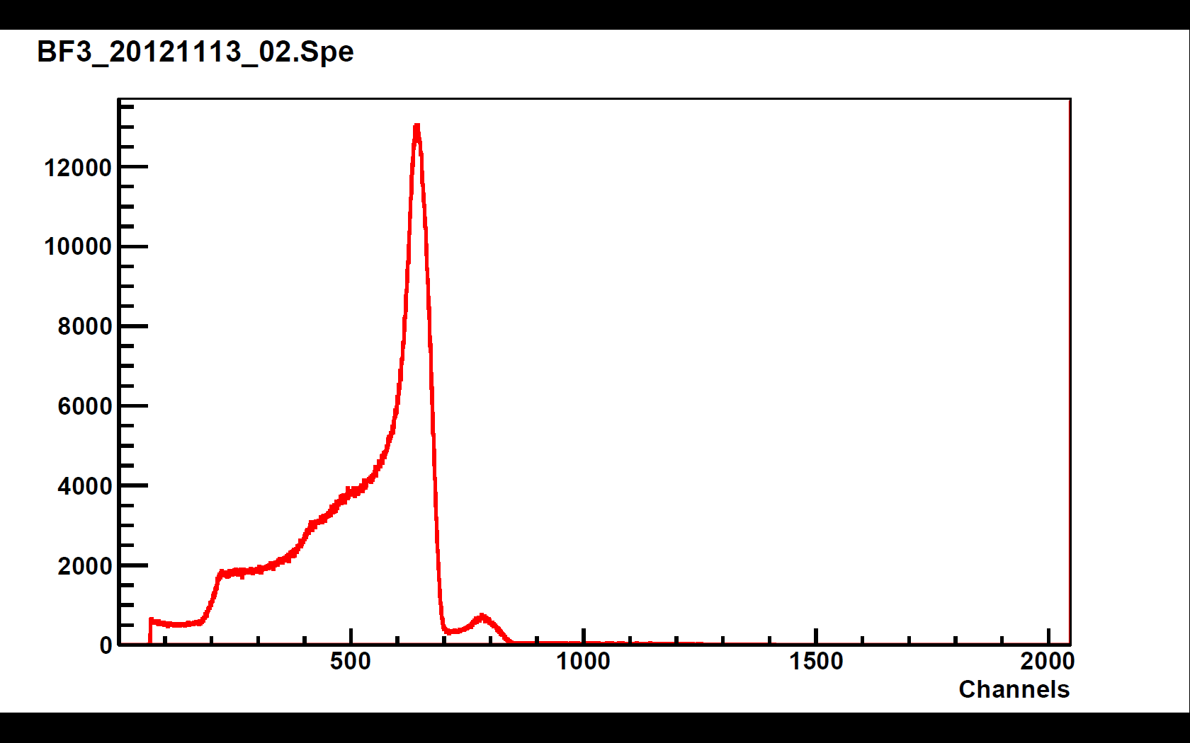
BF3 Spectrum

Slide 8
Finding Deuteron Binding Energy - Tank Spectrum

Slide 9
BF₃ Experiment

